Slide 1
Horseshoes

Slide 2
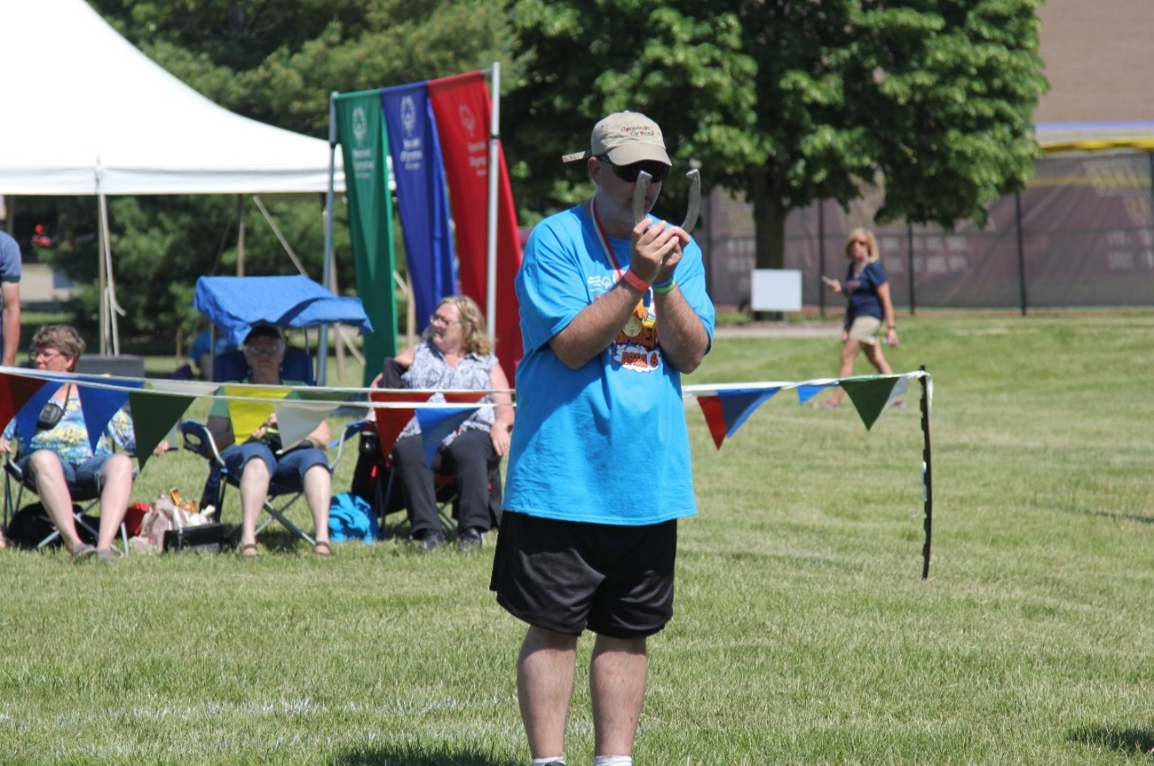
A picture paints a thousand words
“Let me win, but if I cannot win, let me be brave in the attempt.”
Special Olympics Oath
Use the Picture and Caption format to create strong compelling slide like this. Don’t’t forget to caption where possible. For best effect crop the image to fill the placeholder.

Slide 3
General
Sport season:
April -June
Culminating State Event:
State Summer Games

Slide 4
Events Offered
Singles
Doubles
Modified Singles
Modified Doubles

Slide 5
Uniform and Equipment Guidelines

Slide 6
Uniform
Preferred Uniform: White short-sleeve shirt or T-shirt and dress shorts/pants.
Uniforms of all team members should be identical in color and style.
Shoes: Tennis shoes or smooth-soled shoes are recommended
Denim may not be worn during competition or practice

Slide 7
Equipment
A shoe shall not exceed 7 ½” in width, 7 5/8” in length, and shall not weigh more than two pounds and ten ounces.
Each pitcher's box shall consist of an area of clay, synthetic substance, dirt, or sand into which the players throw their shoes and flanked by two pitching platforms or areas from which the players throw their shoes.

Slide 8
General Rules

Slide 9
General Rules
It is the discretion of the tournament director to place athletes in traditional vs. modified at tournaments if the athlete consistently hits the box.
In pitching the shoe, the pitcher shall stand on the pitcher's platform at one side or the other of the stake.
In delivering the shoe, the pitcher must remain behind the foul line until the shoe has left his/her hand. The shoe must be pitched in underhand motion.

Slide 10
General Rules Cont.
No contestant shall move his/her own or opponent's shoe or shoes until the winner of point or points has been agreed upon by contestants or a decision has been rendered by the referee.
Any released horseshoe that has crossed the foul line shall be ruled a pitched shoe and cannot be re-pitched.
In order to count points, horseshoes must land in box. If the horseshoe rolls in the box, it must be removed before the next shoe is pitched.

Slide 11
Event-Specific Rules and Course Set up

Slide 12
Event-Specific Rules
At the State Summer Games, with doubles horseshoes, both athletes will pitch toward the pit in one direction behind the foul line. Partners' points are added together, but the individual records of ringers and shoes pitched should be kept. In all other respects, the game is the same as the conventional singles or walking game.

Slide 13
Course Set up
The court will occupy a level area of at least 50’ in length at least 10’ in width, and consist of two pitcher's boxes, each 6’ square with a stake in its exact center.
The pitching distance for modified will be from the 20’ line with a 17' foul line. The distance for traditional will be from the 30’ line with a 27' foul line.

Slide 14
Course Set up
Stakes shall be 1 inch in diameter and no larger. They may be of cold-rolled steel, mild iron, soft metal, or synthetic material. The top of each stake shall extend not less than 14 inches or more than 15 inches above the level of the pitcher's platform on each side of the stake with a 3 inch incline toward each other.
Foul lines shall be clearly defined three feet in front of the entire edge of the pitcher's box.

Slide 15
Scoring
1.Measurements to determine points shall be made with calipers and straight edge
2.A shoe must be within 6 inches of the stake to score.
3.A ringer is declared when a shoe encircles the stake far enough to allow the touching of both heel caulks simultaneously with a straight edge.
4.There are two official methods of scoring: the cancellation method and the count-all method. The “count-all” method is used at the State Summer Games.

Slide 16
Thank you!

