Slide 1
Snowshoe Official Rules

Slide 2
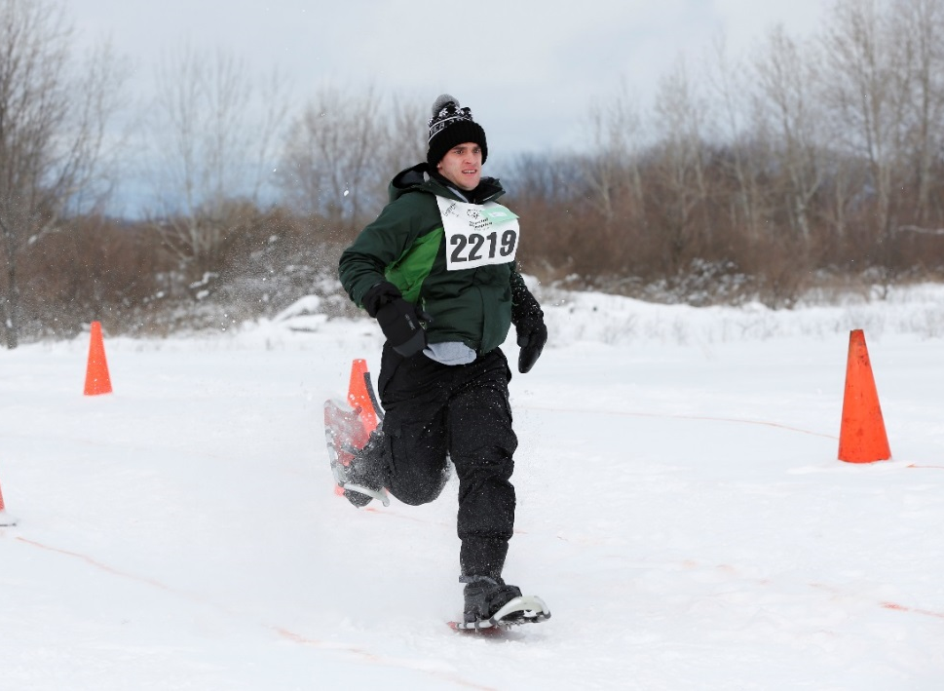
A picture paints a thousand words
“Let me win, but if I cannot win, let me be brave in the attempt.”
“Let me win, but if I cannot win, let me be brave in the attempt.”
Use the Picture and Caption format to create strong compelling slide like this. Don’t’t forget to caption where possible. For best effect crop the image to fill the placeholder.

Slide 3
The Basics
Sport season:
December – February
Culminating State Events:
State Winter Games

Slide 4
Events Offered
25-meter
50-meter
100-meter
200-meter
400-meter
4x100 meter Relay
4x400 meter Relay
4x100 meter Unified Relay
4x400 meter Unified Relay

Slide 5
Uniform Guidelines and Equipment
Athletes should wear appropriate winter sports attire. Warm gloves or mittens, hat, scarf, headband or ski mask, and sunglasses or goggles are recommended.
All competitors must wear competition bibs for all time trials and finals races.
Jewelry and denim may not be worn during competition or practice. Headwear for religious or medical reasons are acceptable but must be brought to the attention of the Games Director prior to competition.

Slide 6
Uniform Guideline and Equipment Cont.
Participants must have their own equipment
Snowshoes should measure at least 7 inches by 20 inches. This measurement shall be taken from the longest point of the snowshoe and at the widest point of the snowshoe.
Snowshoes may not be altered in anyway.
Athletes must use the same snowshoes during time trial and finals competition

Slide 7
Uniform Guideline and Equipment Cont.
Jewelry, and denim may not be worn during competition or practice. Headwear for religious or medical reasons are acceptable but must be brought to the attention of the Games Director prior to competition.

Slide 8
General Rules

Slide 9
Event Modifications

Slide 10
Event Modifications:25-100 Meter
25, 50 and 100 Meter Races: Run on a straight area of the course or on a separate course to allow for events to run concurrently. Lanes should be marked and delineated on the track for the 25, 50 and 100-meter events. These lanes should be at least one meter wide each with wider lanes up to 1.7 meters wide being preferable.
Racecourse area should be as flat as possible and at least 25-100 meters long. A start line should be marked 20 meters long.
The finish line should be marked at 25 meters, 50 meters, and 100 meters from and parallel to the start line.

Slide 11
Event Modifications:200-400 Meter
The track course is a 400-meter continuous loop with a course width of at least 1 meter for each competitor in a race
The direction of competing shall be left-hand inside
The minimum size of the course layout should be 400 meters in length and 7 meters in width. The course should be a continuous hoop over varied terrain.

Slide 12
Event Modifications:Relay
4 x 100 Meter Relays. Run over 400 meter course with 3 exchange zones.
Each zone will be 20m in length and clearly marked. The start of the zone shall be nearest to the starting line.

Slide 13
Unified Snowshoe Rules

Slide 14
Unified Snowshoe Rules
The designated exchange zone is the 20-meter-long space within the vertical planes extending up from two lines on the track 20 meters apart.
A proper exchange of the baton must take place within the exchange zone between the incoming and outgoing runner.
Competitors waiting for the baton can take an inner position on the track as incoming team members approach, provided they do not jostle or obstruct another competitor so as to impede the other competitor’s progress.

Slide 15
Unified Alpine Snowshoe Cont.
If dropped, the baton shall be recovered by the competitor who dropped it. He/she may leave their lane to retrieve the baton provided that, by doing so, they do not lessen the distance to be covered.
Passing of the baton outside the exchange zone shall result in disqualification.

Slide 16
Unified Snowshoe Team Roster
The team shall be made up of two Special Olympics athletes and two Unified Sports® partners.
Each competitor must complete one-fourth of the distance of the total relay. No competitor may complete more than one leg of any one relay.

Slide 17
Thank you!

