Slide 1
Special Olympics Fitness
The mark “CDC” is owned by the US Dept. of Health and Human Services and is used with permission. Use of this logo is not an endorsement by HHS or CDC of any particular product, service, or enterprise.

Slide 2
Mission Statement
Provide year-round sports training and athletic competition in a variety of Olympic-type sport for children and adults with intellectual disabilities giving them continuing opportunities to develop physical fitness, demonstrate courage, experience joy, and participate in a sharing of gifts, skills, and friendships with families, other Special Olympics athletes, and the community.
Notes:
Read through the mission statement and present each component.
Direct attention of coaches to the bold red text that states giving people with intellectual disabilities “continuing opportunities to develop physical fitness.”
Ask coaches: Were you aware that athlete fitness was a fundamental component of the mission of SOI?
Ask coaches: What do you think that SOI means by physical fitness? Specifically, how do you think SOI defines fitness? Encourage all responses and do not correct people, allow them to brainstorm.
Remind coaches that developing fitness should happen during and outside of practice and also year-round, so not just during the sport season

Slide 3
Special Olympics Fitness
Optimal health and performance through adequate physical activity, nutrition, and hydration.
Notes:
Before we proceed further, let’s clarify what fitness means to SOI.
A brief history may help to put this into context. Although it has been a topic of discussion for a long time, we didn’t have a formal focus on fitness within SOI until about 4 years ago. If you’ve been around a while, you have likely seen programs come and go - like TRAIN and Strive and SHIP, but nothing really caught on or made meaningful changes for athletes. We realized that fitness needed to be more of a priority, and in 2015 SOI dedicated a staff member to focus on fitness. Several of our Programs had already been making efforts to improve the fitness levels of their athletes, so SOI reached out to learn from those Programs in developing our definition, vision, and direction for fitness. The SOI fitness team spoke with regional leaders within SOI, Program staff, and some external experts and compiled what we heard to create a simple definition.
SOI defines fitness as: Optimal health and performance through adequate physical activity, nutrition, and hydration. The definition highlights both the benefits of fitness and the behaviors to get there.
There are some components of the definition that are intentionally vague. “Optimal” – this term is relative to a person and refers to a state that is most favorable for a given individual at any given time. “Performance” - notice it does not specify sports performance. Of course it could be sports, but it could also be activities of daily living or work-related performance. “Adequate” – SOI recognizes that what is considered adequate, or enough, will change depending on what “optimal” means to the individual.

Slide 4
Benefits of Fitness for Athletes
Enhanced sport performance through improved
Endurance/stamina.
Speed and agility.
Strength and power.
Flexibility.
Healthy weight.
Increased energy level, improved focus, and better recovery after practices & games.
Reduced risk for sport-related injuries.
Decreased risk for illnesses and chronic diseases.
Improved quality of life.
Notes:
There are many health-related and performance-related benefits of fitness for our athletes. This slide highlights several reasons why fitness is important, though there are many more not listed here.
As you can see, fitness can boost athletic performance through improved levels of endurance, speed, agility, strength, power, and flexibility. Maintaining a healthy weight is also extremely important for overall health and for sport performance, and physical activity and nutrition are vital to achieving a healthy weight.
Through fitness, athletes will have increased energy level and improved focus, and may recover more efficiently after intense games and practices.
Fitness can also assist in preventing and reducing risk for chronic and non-communicable diseases, improve the quality of life, and extend the number of years of life.

Slide 5
Healthy Athletes Data:
Some Cause for Concern
Problem identified | % Athletes SONA
Low Bone Density | 25.6
Overweight or obese* | 73.3
Low Exercise Frequency (<3 days/week) | 35.3
Flexibility Problems | 71.3
Strength Problems | 56.6
Balance Problems | 75.7
*adult athletes with BMI over healthy range
Notes:
Change Healthy Athlete data if you want Program specific statistics.
Despite the importance of fitness to the health and performance of athletes, our Healthy Athlete Data indicate that there is some cause for real concern. These data are related to fitness from athletes in North America. Take a look at these number and tell me what do you think - are we hitting the mark we should be for physical fitness that is called out in our mission statement? These data show that a large portion of our athletes have problems in several areas of health.
In addition to these HA data, the research also shows that individuals with intellectual disabilities (including our athletes) experience disparities in physical activity and fitness levels compared to the general population. Adults and youth with intellectual disabilities are lagging behind people without disabilities and this does not need to be the case.
You might be thinking, isn’t there some reason that our athletes are in poorer health than the general population? Doesn’t that just happen with people with ID? The answer is there is a reason, but it’s not because of their disability.
The answer is FITNESS. If athletes engage in regular physical activity, consume a healthy and balanced diet, and drink sufficient water to maintain hydration, then they can improve their health and we can change the numbers on this slide.
Fitness involves taking ownership and understanding of daily choices and it takes a lot of support - not just from professionals, but from coaches, family, friends, communities. Fitness takes understanding of long term goals because, as you know, positive changes in health take time.

Slide 6
Benefits of Fitness for Athletes
To be a great athlete, you need to be a healthy athlete.
Notes:
There is no denying the evidence – to be a great athlete, you need to be a healthy athlete!
Athletes who have better endurance, are stronger, are at a healthy weight, are properly fueled… they will perform better. And in the eyes of a sports organization, athlete performance is a huge priority.

Slide 7
Promoting Fitness
Fitness should be a seamless part of what you already do.
Small, simple efforts can have a big impact.
Present and reinforce fitness messages.
Be a role model.
Notes:
Your role in promoting fitness is very important and you are well-positioned to make a real impact on the health of our athletes.
Weaving fitness into what you already do is pretty easy, especially since SOI has created a lot of resources and opportunities to support coaches in their efforts to promote fitness.
It is important to know that integrating fitness will not involve a lot more time or energy for you, and it will make a big impact. Or, you can make fitness a real focus and provide lots of additional fitness opportunities for athletes within, and outside, of your practices and competitions. It is up to you, but we hope that you will be inspired to take action!
There are some very simple strategies to encourage fitness within your sport season which I will highlight more on the next few slides. It is as easy as reminding athletes to drink water, or to be physically active outside of practice sessions so that they perform better on the field/court/pool. Promoting fitness could mean you talking to athletes about your activity and healthy food choices.

Slide 8
Physical Activity
Proper warm-up and cool-down – optimize practice sessions and reduce injury risk.
Active practices – maximize athlete engagement and minimize waiting/standing.
Practices include exercise/conditioning – use Fitness Cards to integrate exercises that promote fitness into practices.
Physical activity outside of practice is encouraged – inspire athletes to be active for 30 minutes everyday.
Notes:
Here are some ways to increase physical activity and promote fitness within a sport season. As you can see, these are not overly difficult or technical things but they may involve a bit of planning and organizing. And don’t forget, SOI has lots of resources to assist coaches in their efforts to promote fitness.
Warm up routines are important for preparing athletes for a training session and for reducing risk for injury. Warm up activities should involve some aerobic exercise and can prepare the athlete for pretty intense training.
Keeping athletes active during practice is a great way to promote fitness. Planning ahead to organize the session to minimize time standing and waiting, and maximizing time on task is a great strategy.
Including general or sport-specific conditioning exercises in practice sessions is also an idea to increase strength, endurance, speed, agility, or balance etc. Athletes can set exercise goals and the Fit 5 Guide and/or Fitness Cards can be used to guide coaches and athletes.
Physical activity outside of practice is encouraged – inspire athletes to be active for 30 minutes everyday to enhance sport performance and health.

Slide 9
Nutrition
Connection between nutrition and sports performance is discussed.
Suggestions for healthy meal and snack choices are discussed.
Healthy choices are offered at team meals/snacks.
Notes:
Integrating messages about healthy eating into practices can be very relevant because nutrition and sports performance are so strongly linked. Simple messages about eating fruits and vegetables, limiting treats, and avoiding sugary beverages can be noted by coaches.
Athletes can be encouraged to have healthy meals and snacks, particularly before practices and competitions. You don’t have to be a nutritionist to provide suggestions for healthy, balanced and nutritious food choices.
Healthy foods should be provided at team meals and snacks, and treat foods should not be used as a reward for performance or participation.

Slide 10
Hydration
Provide adequate water breaks during practices.
Simple messages about hydration and performance.
Signs, symptoms and effects of dehydration are presented and reinforced during practice.
Water is encouraged as the best beverage choice both in and out of practice.
Notes:
These are some very simple ways to promote adequate hydration during practice sessions and competition. Also, coaches can be role models and drink water themselves during practices and at competitions.
Providing water breaks and reminding athletes to drink water regularly is a great way to reinforce the importance of hydration. Especially when it’s hot weather.
Athletes should be aware of the signs of dehydration and how that can affect their performance and health.
Encouraging water and generally discouraging sugary beverages, except for a treat, is the way to go here. Even sports drinks should be avoided as a regular beverage choice since they have a high sugar content.

Slide 11
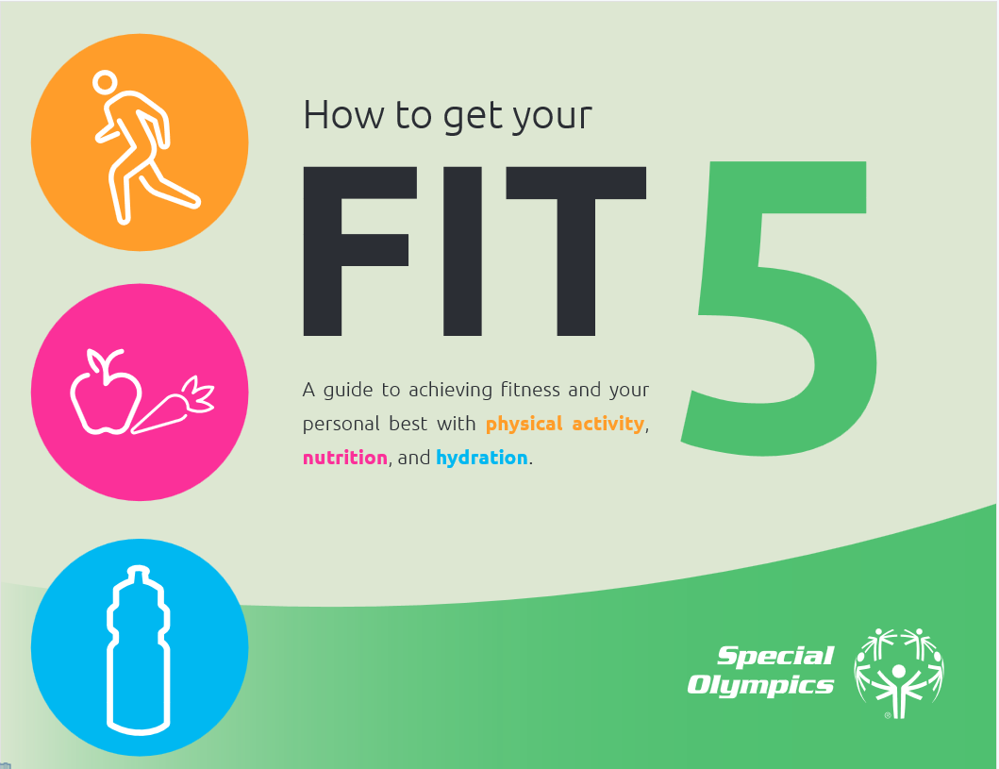
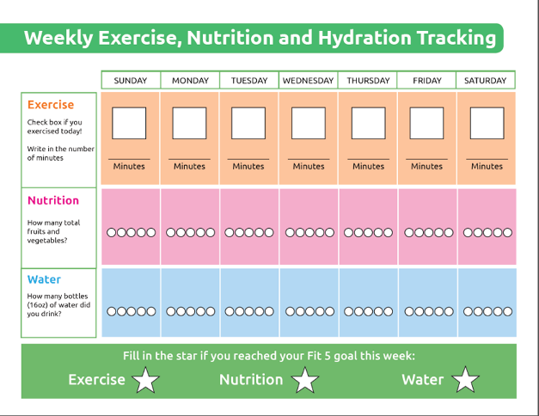
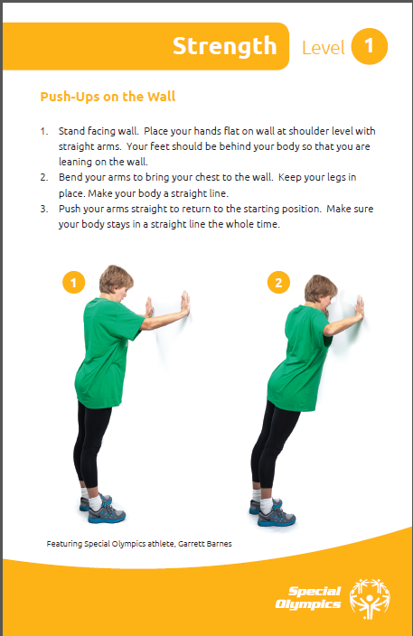
Resources to Promote Fitness
Notes:
One great resource that SOI has created is the Fit 5 Guide. There are lots of ideas for achieving fitness, including adequate physical activity, nutrition, and hydration, and it includes tracking sheets and great visuals.
This is only one example of a resource that is available, we also have Fitness Cards, sample practices and workouts, nutrition tip sheets, a fitness assessment guide for those coaches who would like to examine any improvements in fitness of their athletes – this can be a great motivator. There are also warm-up and cool-down suggestions, FAQ sheet, and a guide for organizing active practice sessions.
You are encouraged to review and use these very user friendly resources to inspire you to integrate fitness into the great work that you already to.

Slide 12
Supporters
Athletes!
Family Members
Other coaches
Fitness Professionals
College students
Notes:
Show your team that you value fitness as an important part of training by keeping hydration, nutrition, and physical activity top of mind. As we showed you, there are many ways to make sure fitness is part of your sports season that require no expertise and very little time.
In addition to the great resources that SOI has that can empower you to integrate fitness into your program, you can also recruit others to help and support you.
For example, you can ask an athlete leader, family members, other coaches, or a fitness professional in the area to take the lead on fitness. There may also be students at local colleges with expertise in exercise science or physical education who may be looking for an opportunity to gain some practical experience and contribute to a local sports program.
Remember, fitness is the vehicle by which our athletes can perform optimally and achieve good health. Let’s work together to ensure that fitness is a priority in our programs.

