Slide 1
Poly Hockey Official Rules

Slide 2
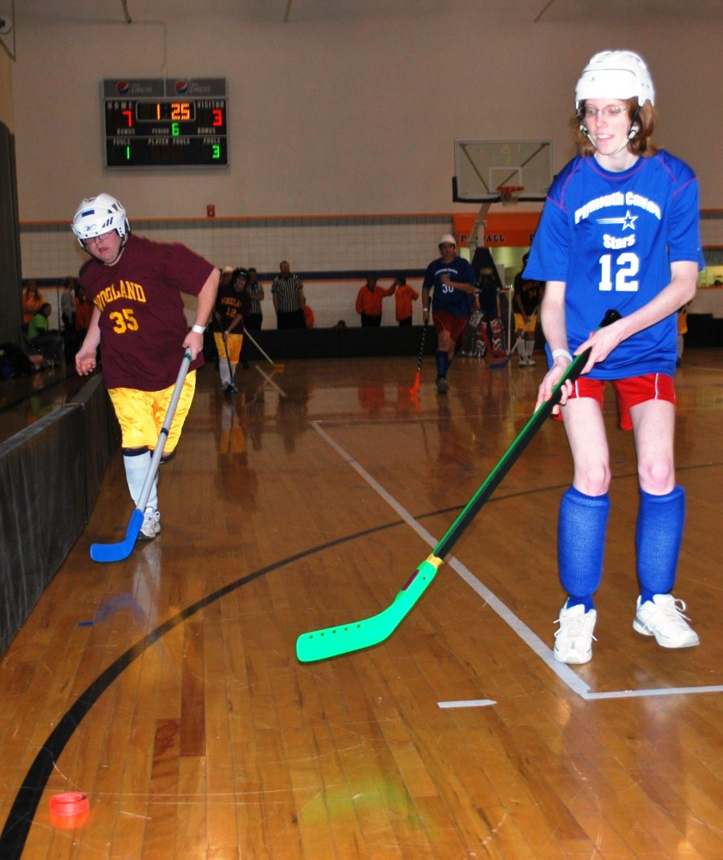
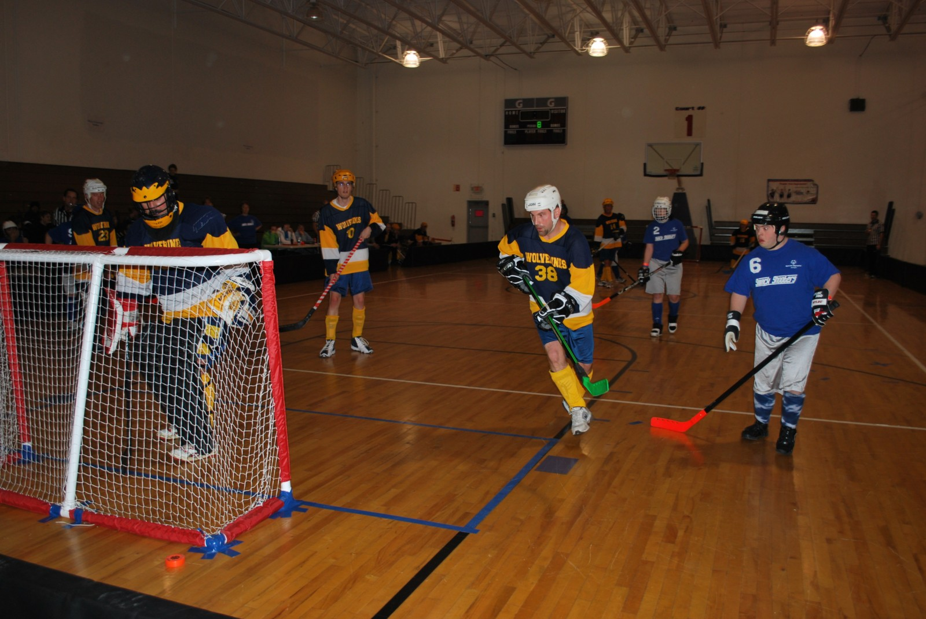
Events Offered
Team Competition
Unified Team Competition
Individual Skills Competition

Slide 3
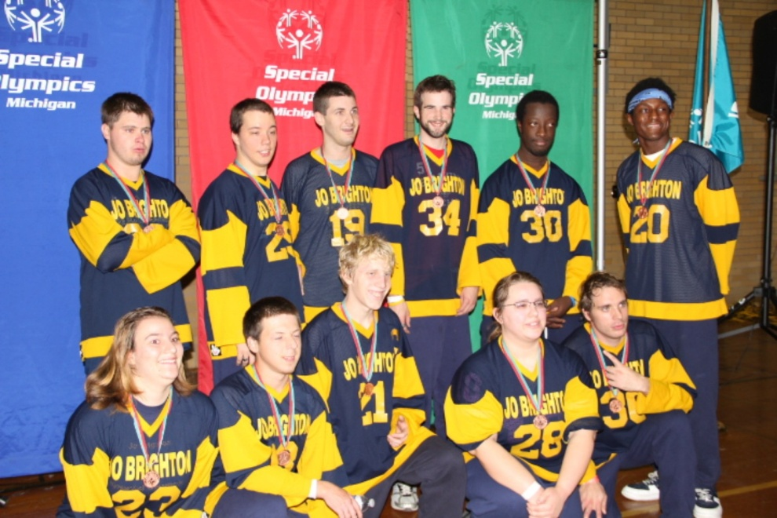
Uniforms
Required
Large, identifiable numbers on front & back or on back & sleeves
Hockey helmets and protective shin guards (under socks) are required
Goalkeeper- face mask and throat protector
Optional
Goalkeeper- catching glove, blocking pads, mouth guard and protective cup
Elbow pads, knee pads, protective cups and gloves

Slide 4
Uniforms Continued
Shorts and/or sweatpants are acceptable.
Athletes should wear athletic, non-marking sneakers.
Denim is not allowed to be worn during competition.
All jewelry is prohibited during gameplay.All team uniforms must have the Special Olympics logo adorned somewhere on the jersey.
Logos may be placed on the front, back or sleeve and may be located on the top of bottom of the uniform and should be visible.
Logos may be screen printed or embroidered or may be part of a patch or sticker.

Slide 5
Uniforms
Goalkeeper leg guards must not exceed 12 inches in extreme width and must not be altered.

Slide 6
Equipment
Pucks must be soft, indoor, orange plastic pucks.
Net
48 inches high.
72 inches wide.
14 inches deep at the top, 24 inches deep at the bottom.

Slide 7
Equipment - Helmets
All athletes must wear a hockey style helmet with a facemask.
Helmets no longer need an HECC certification but must include a chinstrap and be securely fastened at all times.
Skills athletes must wear a helmet; however, they do not need facemasks.
All players on the players’ bench and the penalty bench must wear the protective helmet/facemask while in the bench area.
For a violation of this rule, after a warning by the Referee, a misconduct penalty for an equipment violation shall be assessed to the offending player.

Slide 8
Equipment - Sticks
Poly Hockey sticks are a plastic manufactured indoor floor hockey stick.
Sticks must not be modified in any way.
This includes adding a dowel, sand or any other material to strengthen the handle.
Friction tape on the blade of the stick is NOT ALLOWED
Sticks must have a plastic cap at the top of handle
Sticks must not exceed 53 inches in length from the heel to the end of the shaft and no more than 11.5 inches from the heel to the end of the blade
The blade shall not exceed 2.5 inches in width.

Slide 9
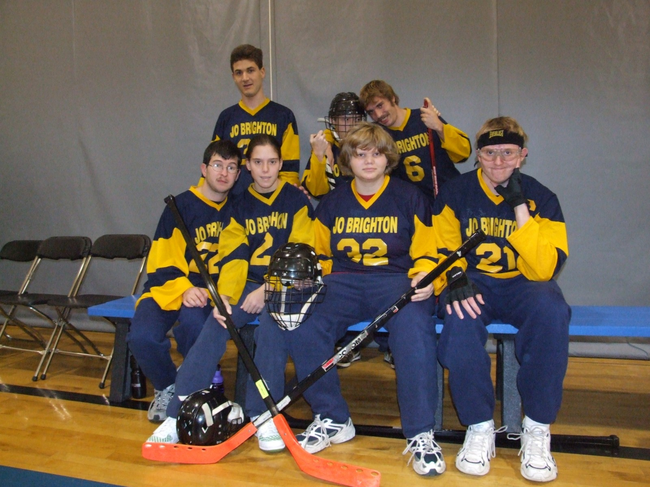
Equipment - Sticks
Center’s stick must be wrapped in a contrasting tape compared to the rest of the sticks.
Goalkeeper’s stick must have a plastic blade.
They may have a wooden shaft.

Slide 10
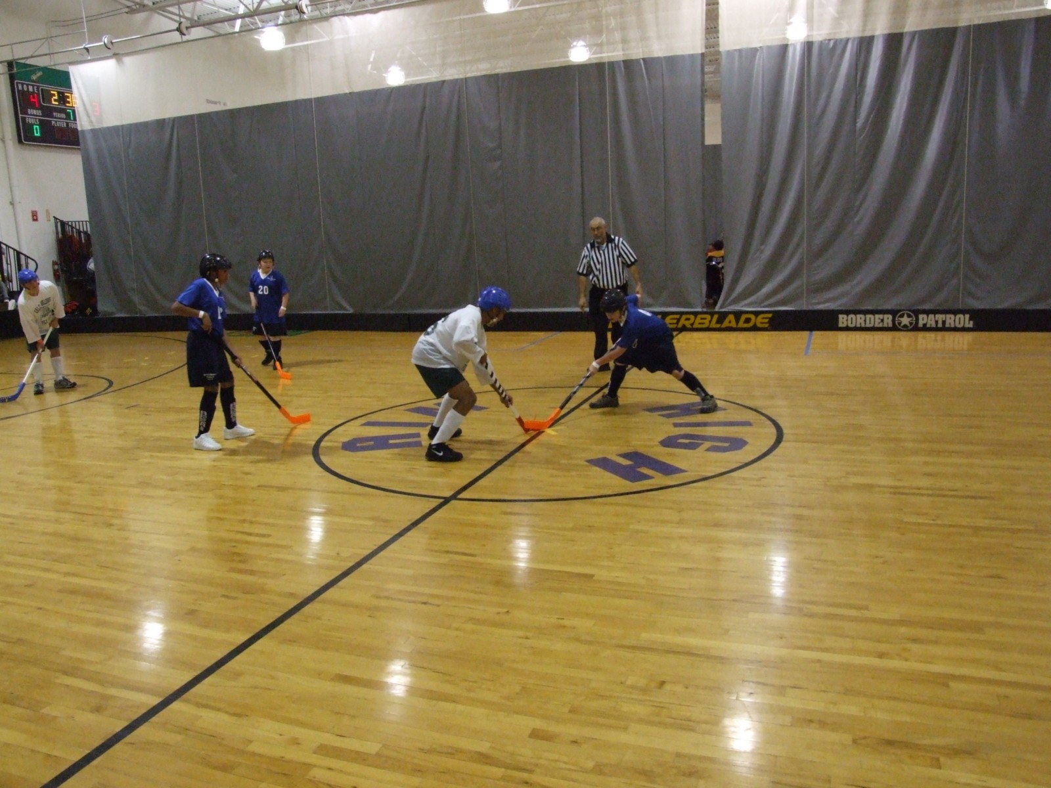
Hockey Court
Maximum court size is 40 feet by 80 feet.
Center line splits the court into two halves.
There is one Center Face-Off Circle in the middle of the court and two Face-off Circles on each end of the court.
The back of the goal should sit 2 feet from the back boards.

Slide 11
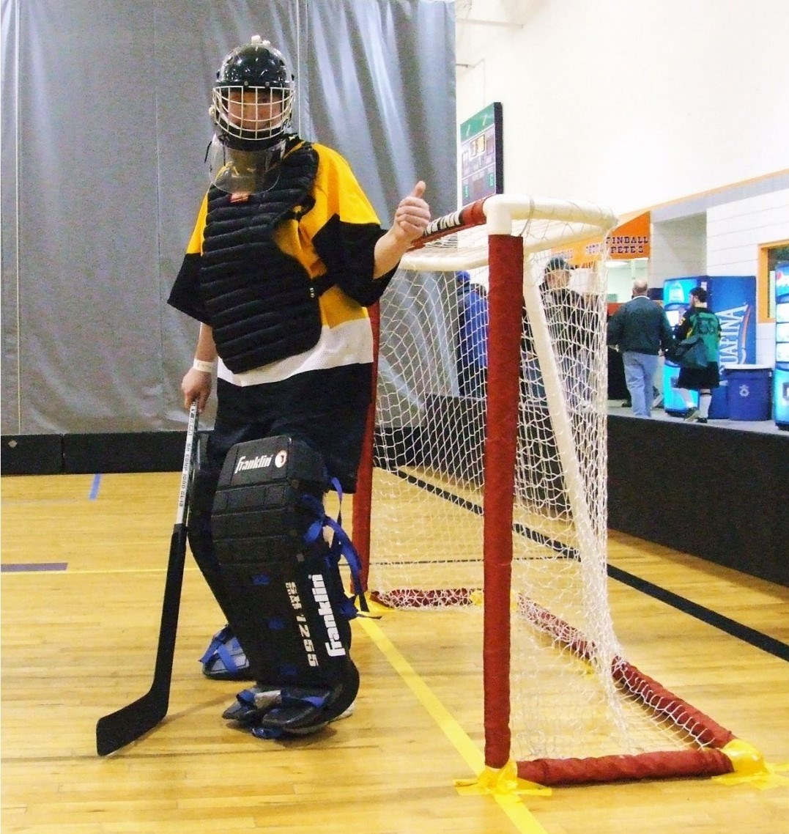
Hockey Court
Goal Crease
Measure 5 feet x 12 feet and is centered in front of the goal..
Only the goalie and goalie equipment (stick, glove, etc. is allowed inside the goal crease).

Slide 12
Sample Court

Slide 13
Gameplay
Games include Nine three-minute periods.
Face-offs occur at the start of the game and after a scored goal.
Time of Play
Clock will stop when a goal is scored, or any type of foul is called.
Clock will resume within 15 seconds.
Referee will drop a new puck if the one in play happens to go out of bounds.
Overtime is sudden death.
Each team is allowed one time-out per game.

Slide 14
Gameplay
Mercy Rule- once a team is ahead by a certain number of goals (determined by the tournament director) the clock will be a running clock.
Players may trap the puck with their feet or sticks.
Trapping occurs when a player stops the puck with the side of their foot. Players may NOT step directly on top of the puck.
Players may catch the puck and drop it perpendicular to the floor.
If the puck hits a referee the puck remains in play

Slide 15
Players
Players
Roster: Minimum of 7 players and maximum of 13 per team
Each line will consist of:
2 defensive players (who can only play the defensive half of the court).
2 forwards (who can only play on the offensive half of the court).
1 center (can play both offense and defense).
1 goalie.
All centers must have a stick that is marked by a stripe down the shaft using tape wrapped around the shaft.
Any player can be substituted at any stoppage of play and can play any position
A goalie may be pulled during any stoppage of play. The player substituted may be placed as an additional forward.

Slide 16
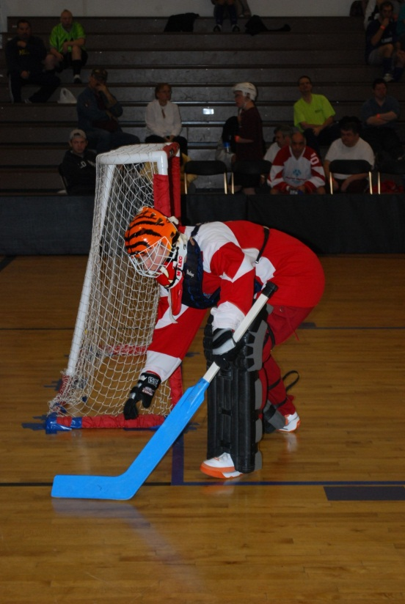
Goalkeeping
Goalkeeper may use his or her hands to clear the puck away from the goal or crease
A dotted line will extend from the goal crease at a 45-degree angle to the side face off circles. The goalkeeper may sweep or toss the puck in an underhand manner outside these lines
The goalkeeper may shoot the puck, using their stick, in any direction without the 45-degree restrictions but must remain in the crease to do so

Slide 17
Goalkeeping
The goalkeeper may not hold the puck for more than 3 seconds
The goalkeeper must start in the standing position.
The goalkeeper may go down in front of the goal to make a save, but may not remain on the ground in front of the goal for more than 3 seconds
The goalkeeper must remain in contact with the crease when playing the puck
The goalkeeper may be pulled and can be placed back in the game during any stoppage of time

Slide 18
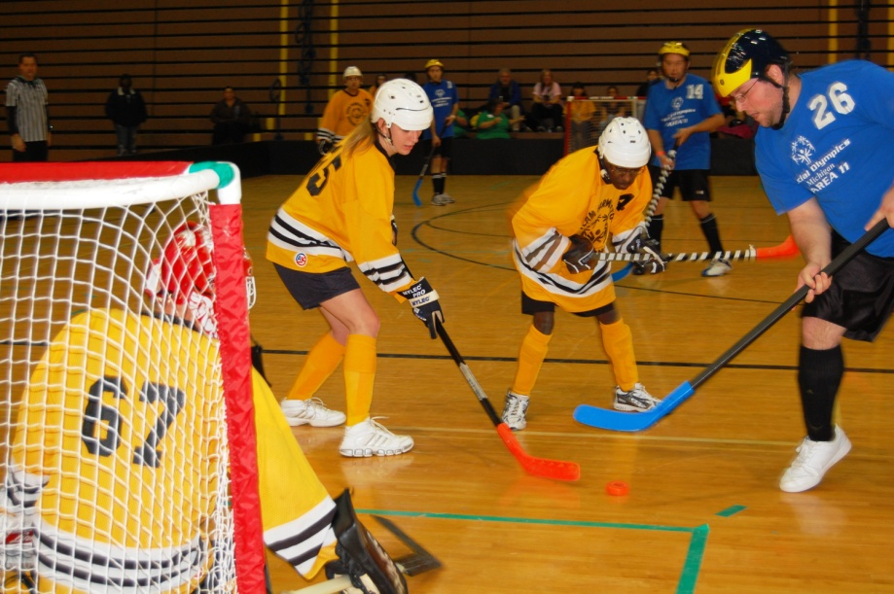
Scoring
A goal is score when the puck completely breaks the vertical plane of the goal line.
A puck resting on the goal line is not a goal.
The puck cannot be kicked or thrown into the goal by an offensive player.
A goal cannot be scored on an offensive foul or an offensive player in the goal crease.
You may score from a face-off.
Goalies may score if the puck is shot legally.

Slide 19
Minor Fouls
Result in stoppage of play and a face-off in the offending team’s defensive face-off circle.
A delayed penalty may be called.
Examples of minor fouls:
Player deliberately holds, lies on or steps on the puck.
Goalkeeper contacts the puck when he/she is not in the crease.
Forward or defensive player crosses the center court line.
Offensive or defensive goes into the crease at any time (including stick).
Deliberate roughness takes place.
When a player wears jewelry or hard hair ornament outside the helmet.
When a player enters the game with illegal uniform or equipment.

Slide 20
Minor Fouls
When a goalkeeper uses an overhand throw or clears the puck to the center (not using stick).
When the goalkeeper is pulled, and the puck stops in the crease.
When a player does not remain stationary during a face off.
When a player other than the goalkeeper deliberately leaves his/her feet to block a shot.
Goalkeeper does not return to his/her feet within 3 seconds of going down to block a shot.
High sticking (any stick raising above the waist.)

Slide 21
Major Fouls
Two-minute expulsion of offending player or line captain (if the penalty is called on the bench), creating a power play
Penalty is discontinued if opposing team scores
Example of major fouls:
Excessive roughness.
Cross-checking.
When a player accumulates 5 minor fouls.
Elbowing.
Unsportsmanlike conduct.
After a total of 10 minor fouls a player is given a second two-minute expulsion and cannot re-enter the game.

Slide 22
Ejection Penalty
Must leave the building for the remainder of the game
All spectators are an extension to the team and can be asked to leave if their behavior merits ejection
Examples:
Deliberately causes injury or harm to another player.
Coach’s misconduct becomes detrimental.
Intentionally throwing or swinging a stick.
Player commits two major fouls.
Player commits ten minor fouls.

Slide 23
Individual Skills Contest
The individual Skills Contest is designed for lower ability, or new, athletes who have not yet developed the skills necessary to participate meaningfully in team competitions, and atheltes who use a wheelchair. Athlete may not be assisted by coaches and modifications may be made for athletes who have visual or hearing impairments.
Events Include:
Shoot Around the Goal
Pass
Stick Handling
Shoot for Accuracy

Slide 24
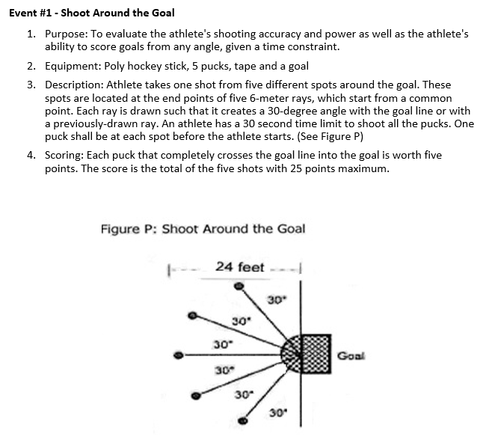
Individual Skills Contest Shoot Around the Goal

Slide 25
Individual Skills Contest Pass

Slide 26
Individual Skills Contest Stick Handling

Slide 27
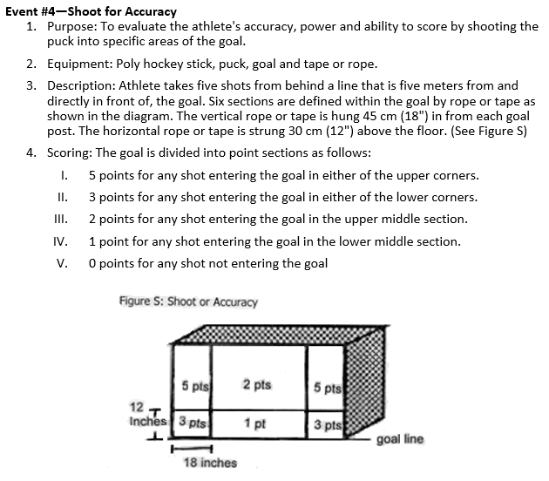
Individual Skills Contest Shoot for Accuracy

Slide 28
Terms
Center circle: Where face offs take place at the beginning of a period and after a goal is scored
Clearing the puck: When a player gets the puck out of his/her defensive zone
Cross check: When a player holds the stick horizontally and shoves another player with it (illegal)
Goal crease: The area defined by a line that the goalie must remain in contact with at all times. No other player’s body or stick may enter
High sticking: Carrying or raising the stick above waist level

Slide 29
Terms
Holding: Impeding the progress of an opponent
Interference: Holding or impeding the progress of an opponent who is not in possession of the puck
Lift shot: A shot in which the puck rises off the floor
Rebound: When the puck bounces off the goalie equipment, body or goal posts.
Screen: Standing in the line of site between the puck and goalie
Stick check: Lifting the opponents stick off the puck
Wall pass: Using the boards to assist with passing

